Slide 1

Azure Bastion

Slide 2
The VM Administrative Access Problem Space

Slide 3
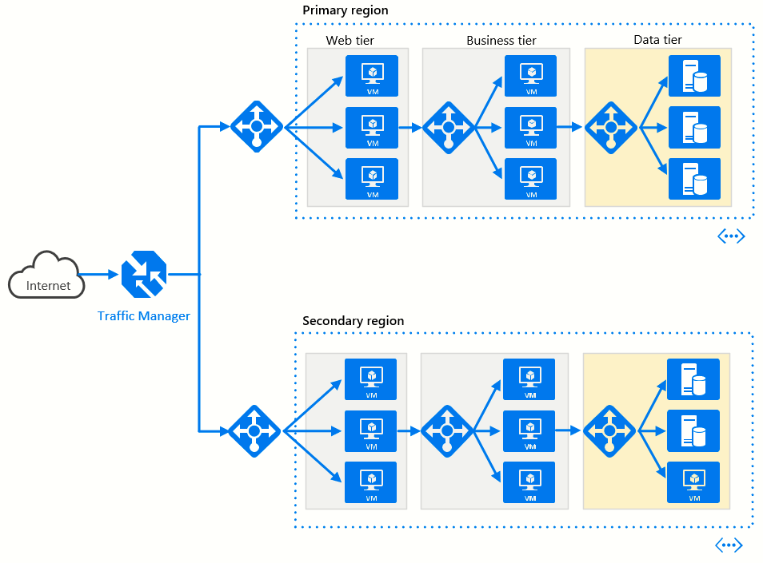
You need to manage your VMs running in Azure…
RDP (TCP 3389)
SSH (TCP 22)

Slide 4
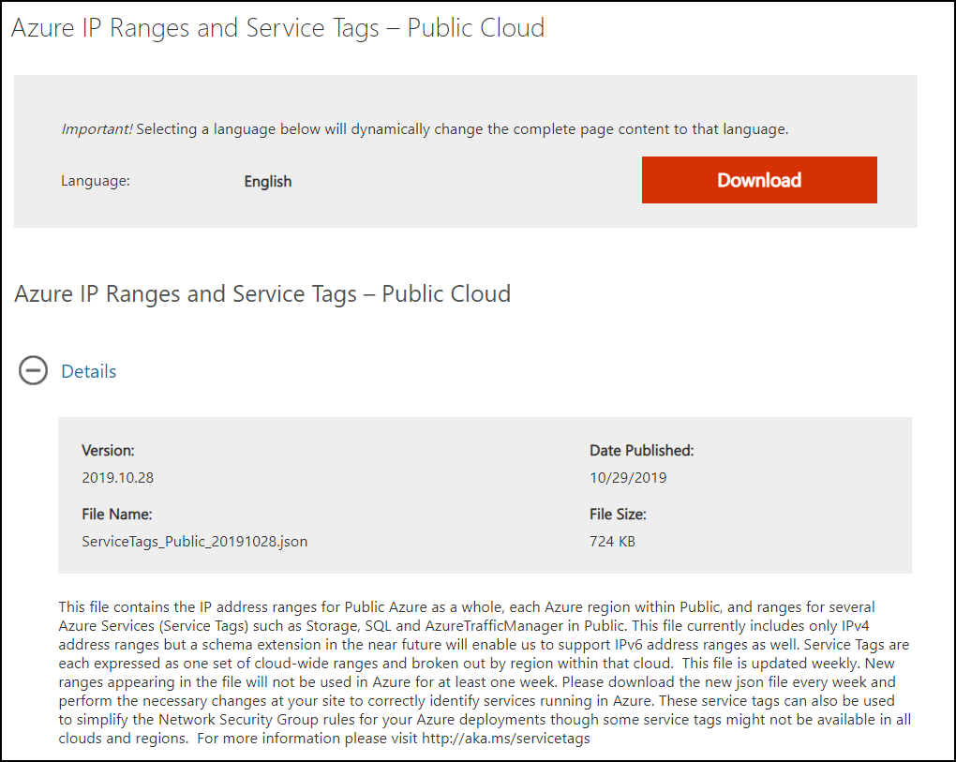
…and you need to prevent breaches
Port scan
Brute force

Slide 5
Common VM administrative access methods

Slide 6
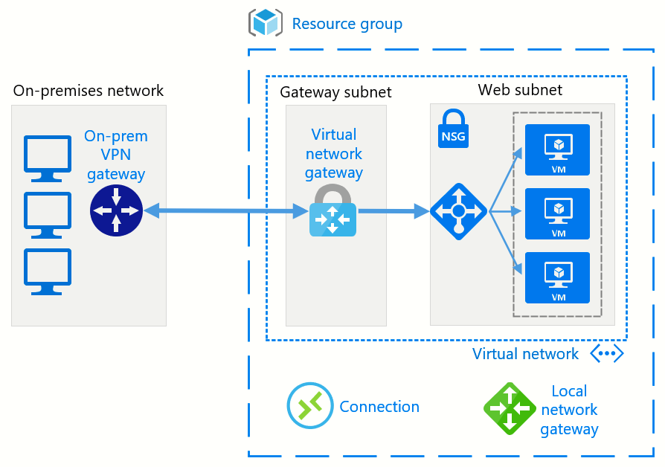
Hybrid cloud
S2S VPN
ExpressRoute

Slide 7
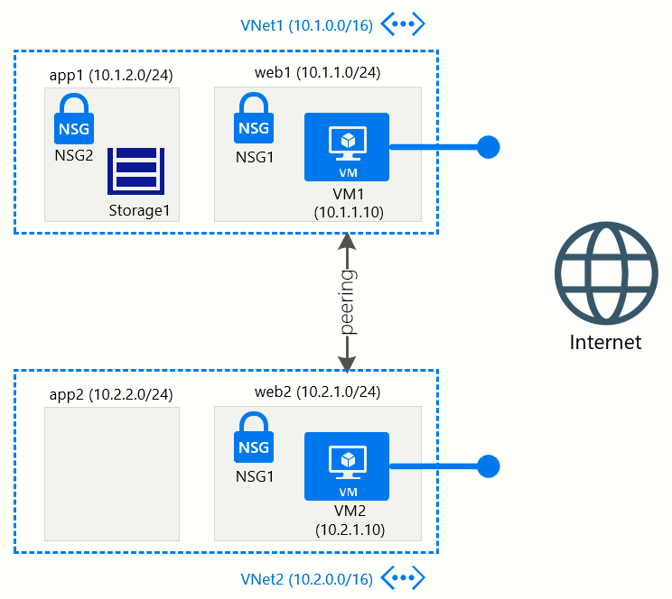

VMs with public IP addresses (PIPs)

Slide 8
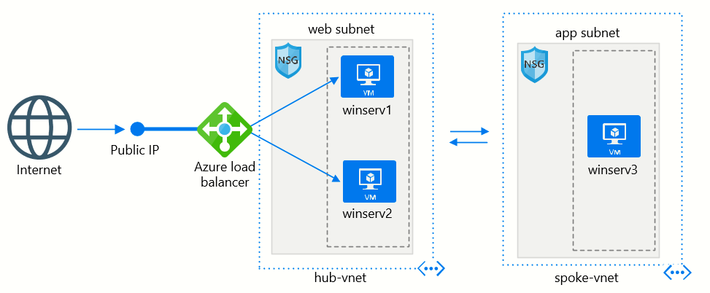
NAT through Azure Load Balancer
“Security” through obscurity

Slide 9
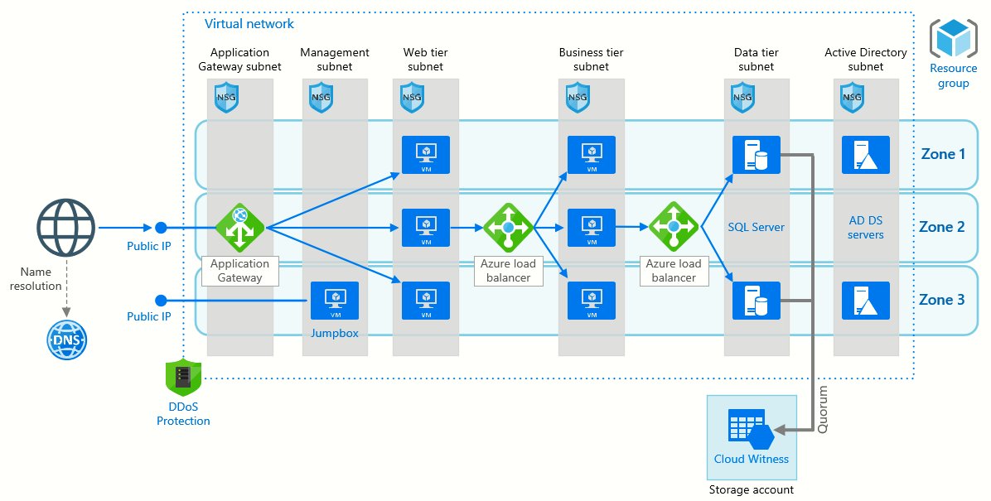
Jump box
Another resource for you to update, backup, troubleshoot…

Slide 10
Azure Bastion

Slide 11
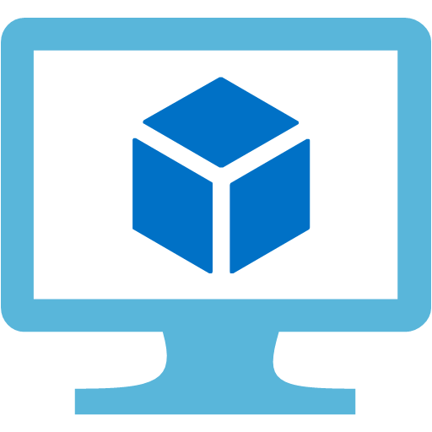



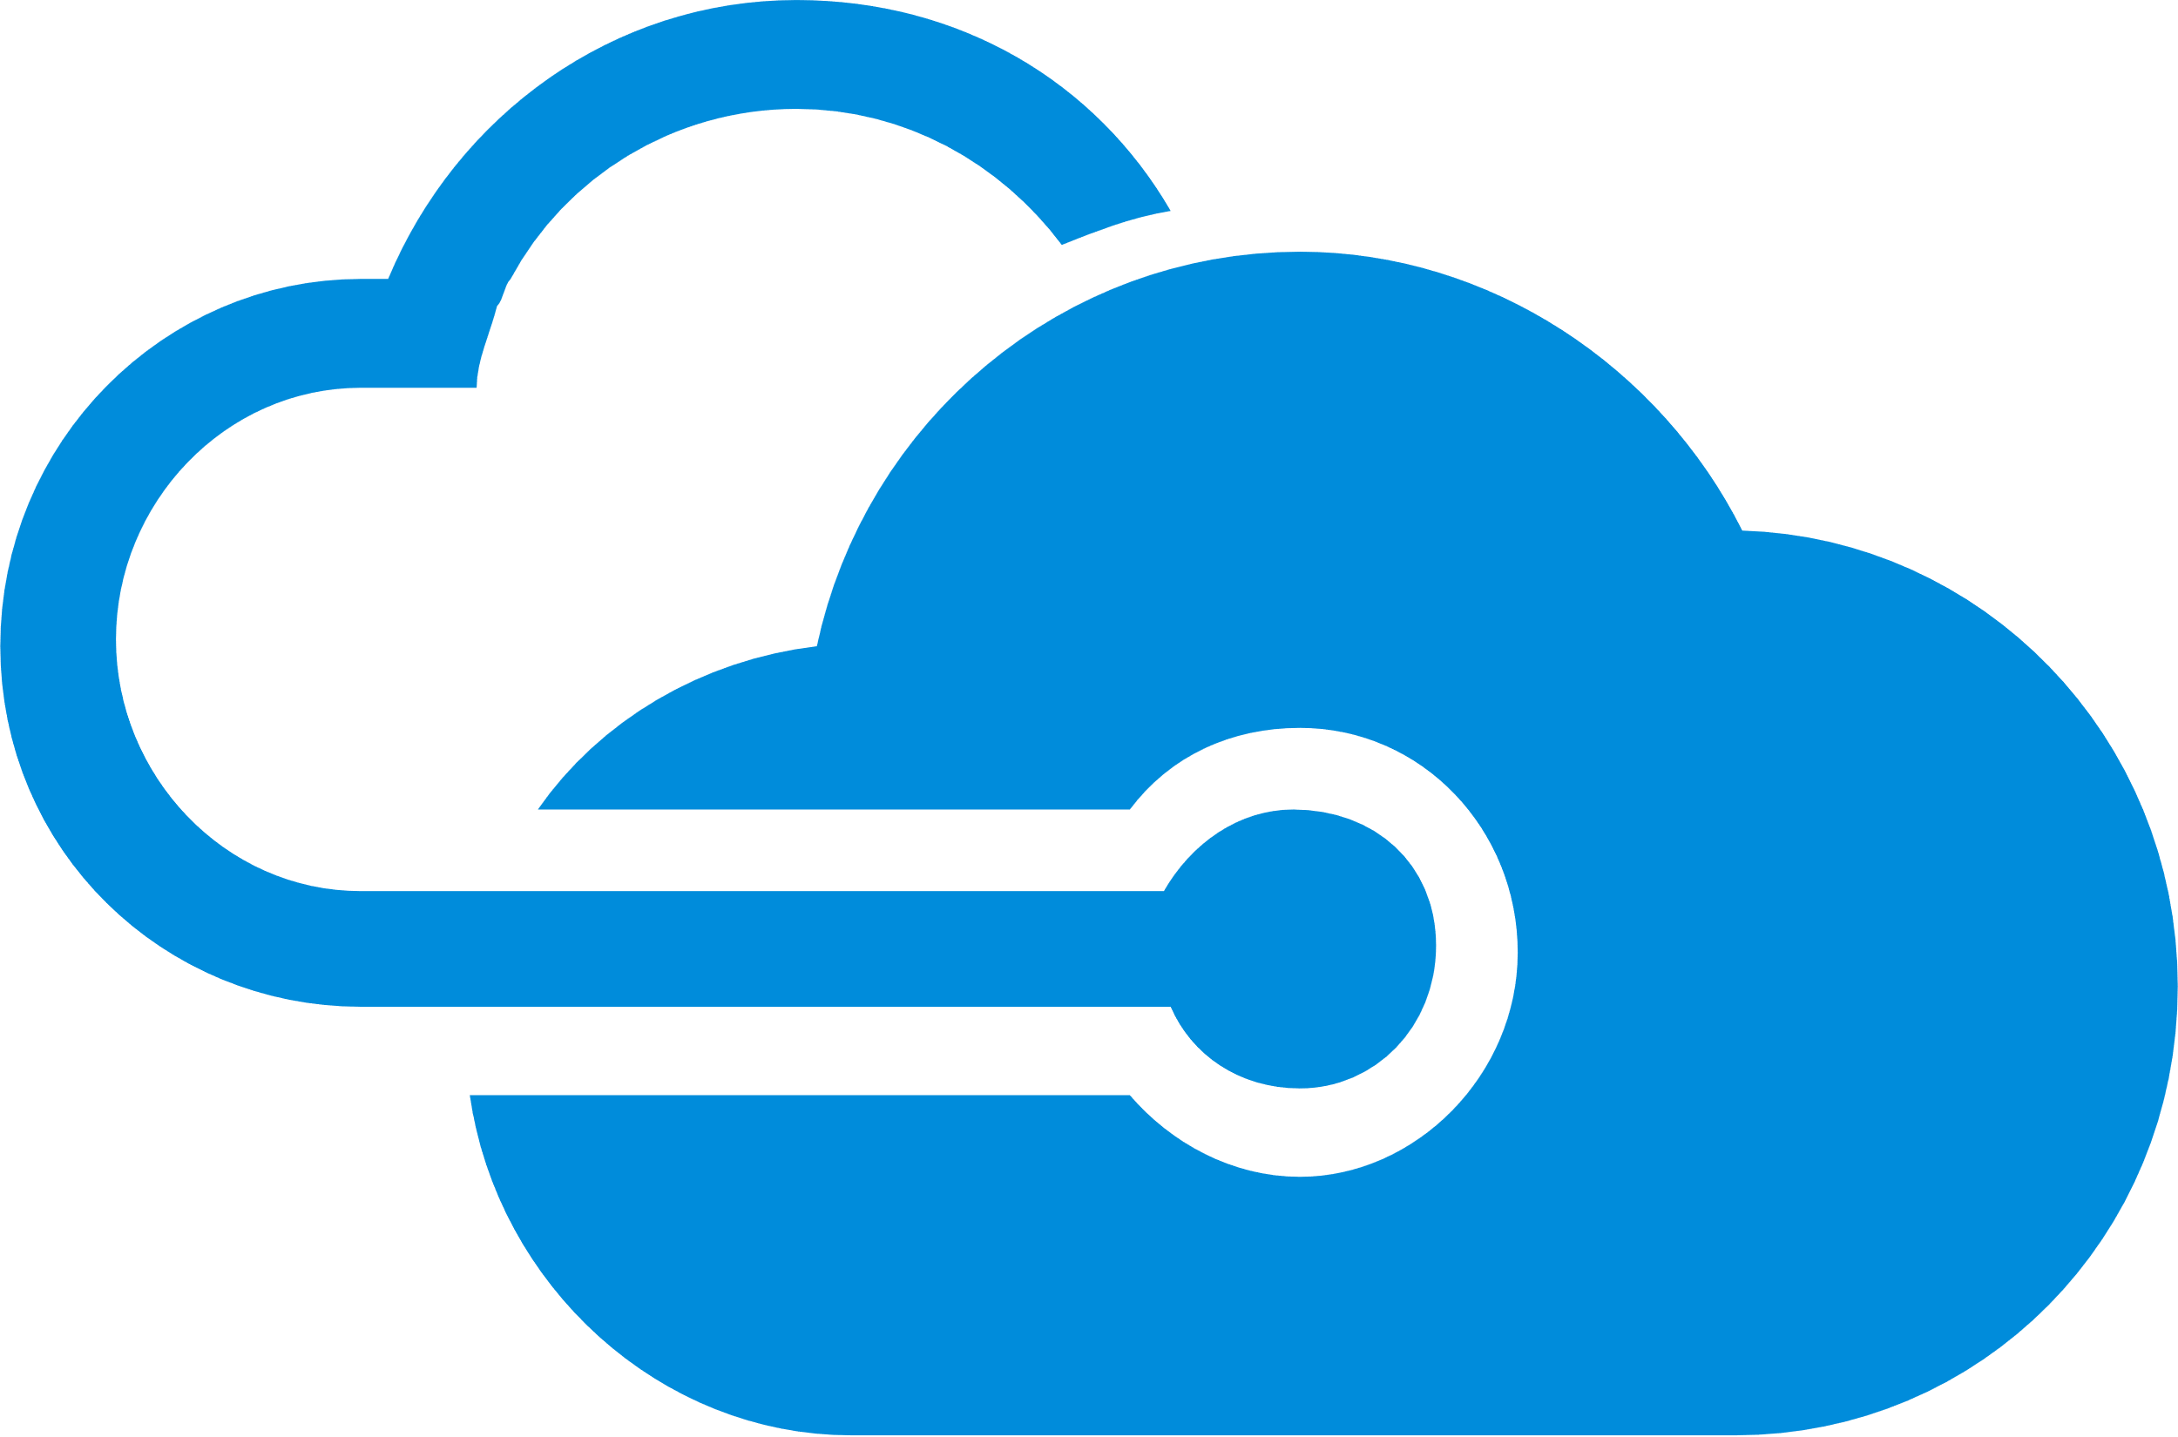

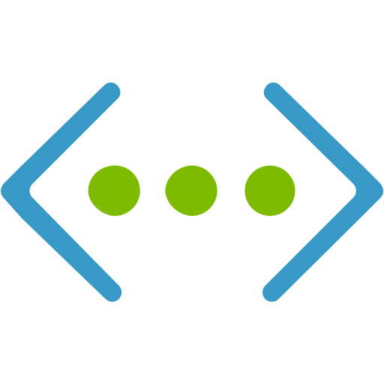
Azure Bastion – Managed jump box
Only RDP/SSH allowed from Bastion
Only port 443 (HTTPS) exposed to the Internet
No public IPs
VNET-injected managed appliance
Private IP
Port: 3389, 22
“Gateway Manager”
Bastion controller
Azure VM
Remote Protocol
(RDP, SSH)
TLS
Azure VM
TLS
Internet
Port 443
Azure VM
Azure Portal
Azure Bastion
Target VM Subnet(s)
AzureBastionSubnet
Virtual Network

Slide 12
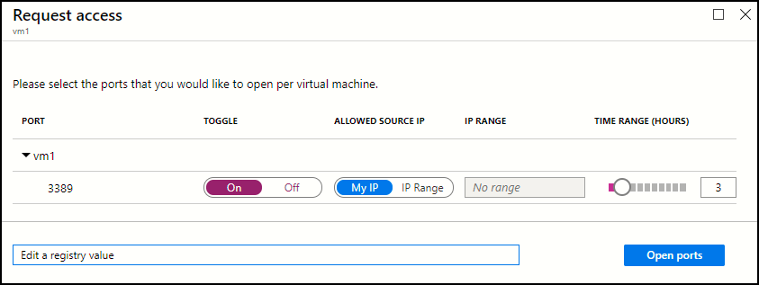
JIT VM Access
JIT VM Access is complementary to Azure Bastion

Slide 13
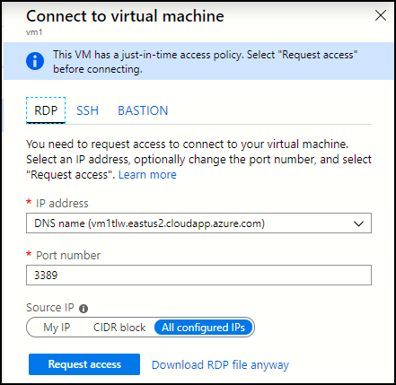
JIT VM Access
JIT VM Access is complementary to Azure Bastion

Slide 14
Azure Bastion roadmap
Native RDP/SSH clients over SSL (currently in preview)
RDP full-session recording for auditing
Azure AD SSO with MFA
Azure AD PIM integration
Private IP for Bastion host (access through ExpressRoute or S2S VPN)

